Slide 1
MUSIC RECORD DATABASE
SUBMITTED BY-
SARTHAK BAJAJ-19BCE0710
KHUSHI AGRAWAL-19BCE0418
AVIRAL GOYAL-19BCE0883

Slide 2
ABSTRACT
The music record database project is to categorize and catalog all the songs for their information like their genre, singers, lyricist, from where to download etc.. This idea was selected by us due to our common interest in music and also the fact that often we remember a song by not its name but by its some other info like album name or singer name and so we wish to provide the users with a space where they can find the music they are looking for or that they desire to listen without surfing through the whole internet.

Slide 3
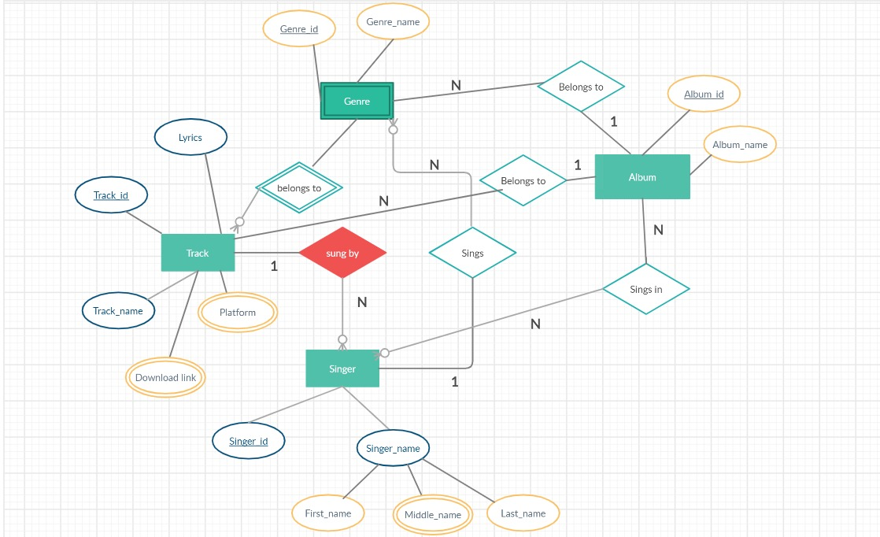
ER-DIAGRAM

Slide 4
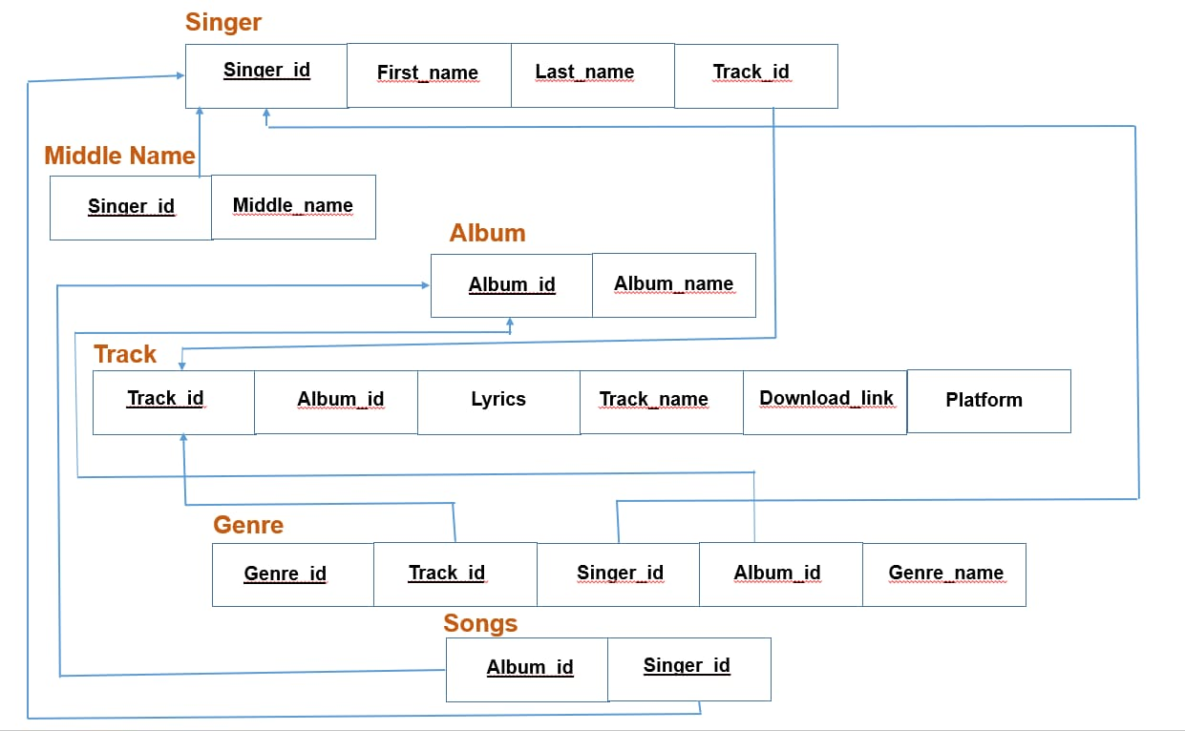
RELATIONAL SCHEMA

Slide 5
TABLES AND CONSTRAINTS
Singer
ATTRIBUTE | DATATYPE | CONSTRAINT
Singer_ID | varchar(5) | Primary key
First_Name | varchar(20) | Not null
Last_Name | varchar(20)
Track_ID | varchar(5) | Foreign key

Slide 6
Middle Name
Album
ATTRIBUT
ATTRIBUTE | DATATYPE | CONSTRAINT
Singer_ID | varchar(5) | Primary key
Middle_Name | varchar(20)
ATTRIBUTE | DATATYPE | CONSTRAINT
Album_ID | varchar(5) | Primary key
Album_Name | varchar(50) | Not null

Slide 7
Track
ATTRIBUTES | DATATYPES | CONSTRAINTS
Track_ID | varchar(5) | Primary key
Album_ID | varchar(5) | Foreign key
Lyrics | varchar(10000000000)
Track_Name | varchar(50) | Not null
Download_Link | varchar(10000000000)
Platform | varchar(20)

Slide 8
Genre
ATTRIBUTES | DATATYPE | CONSTRAINT
Genre_ID | varchar(5) | Primary key
Track_ID | varchar(5) | Foreign key
Singer_ID | varchar(5) | Foreign key
Album_ID | varchar(5) | Foreign key
Genre_Name | varchar(20) | Not null

Slide 9
Sings_In
ATTRIBUTES | DATATYPE | CONSTRAINT
Singer_ID | varchar(5) | Primary key
Album_ID | varchar(5) | Primary key

Slide 10
DATA COLLECTION
ALBUM | SONG | LYRICIST | SINGER | GENRE | LYRIC LINK | DOWNLOAD LINK
Anjaana Anjaani | Hairat | Vishal Dadlani | Lucky Ali |  | http://www.lyricsoff.com/songs/hairat.html | https://www.pendujatt.net/hindi-songs/song/hairat-hai-hairat-hai-lucky-ali-lmw.html
 | Aas Paas Khuda | Vishal Dadlani and Shekhar Ravjiani | Rahat Fateh Ali Khan |  | http://www.lyricsoff.com/songs/aas-paas-hai-khuda-anjaana-anjaani.html | https://www.pendujatt.net/hindi-songs/song/aas-pass-hai-khuda-rahat-fateh-ali-khan-lmr.html

Slide 11
 | Tumse Hi Tumse | Amitabh Bhattacharya and Anvita Dutt Guptan | Shekhar Ravjiani and Caralisa Monteiro |  | http://www.lyricsgram.com/song/tumse-hi-tumse-2708 | https://www.mr-jatt.im/latest-music/song/61827/Tumse-Hi-Tumse-Anjaana-Anjaani-Various-mp3-song.html
 | Tujhe Bhoola Diya | Kumaar and Vishal Dadlani | Mohit Chauhan, Shekhar Ravjiani and Shruti Pathak | Romantic, sad | http://www.lyricsoff.com/songs/tujhe-bhula-diya.html | https://www.pendujatt.net/hindi-songs/song/tujhe-bhula-diya-mohit-chauhan-shekhar-ravjiani-shruti-pathak-ajmvx.html

Slide 12
 | I Feel Good | Vishal Dadlani | Vishal Dadlani and Shilpa Rao | Love | https://www.lyricsbogie.com/i-feel-good/ | https://www.pendujatt.net/hindi-songs/song/i-feel-good-teri-meri-vishal-dadlani-shilpa-rao-lnm.html
 | Anjaana Anjaani Ki Kahaani | Neelash Misra | Nikhil D’Souza and Monali Thakur | Romantic, Happy,Dance, Party | http://www.lyricsoff.com/songs/anjaana-anjaani.html | https://www.pendujatt.net/hindi-songs/song/anjaana-anjaani-ki-kahani-monali-thakur-nikhil-d-souza-lmt.html
Dangal | Haanikarak Bapu | Amitabh Bhattacharya | Sarwar Khan, Sartaz Khan Barna, Saddy Ahmad |  | https://lyricsily.com/lyrics/hanikarak-bapu-lyrics-dangal-aamir-khan | https://www.pendujatt.net/hindi-songs/song/haanikaarak-bapu-sarwar-khan-sartaz-khan-barna-amiva.html

Slide 13
 | Dhaakad | Amitabh Bhattacharya | Raftaar | Hip-Hop, Rap | https://www.lyricsmint.com/dangal/dhaakad | https://www.pendujatt.net/hindi-songs/song/dhaakad-raftaar-amorj.html
 | Gilehriyaan | Amitabh Bhattacharya | Jonita Gandhi |  | https://www.lyricsmint.com/dangal/gilehriyaan | https://www.pendujatt.net/hindi-songs/song/gilehriyaan-jonita-gandhi-ammxt.html
 | Dangal | Amitabh Bhattacharya | Daler Mahendi |  | https://www.lyricsmint.com/dangal/dangal-title-track | https://www.pendujatt.net/hindi-songs/song/dangal-daler-mehndi-dshfq.html

Slide 14
 | Idiot Banna | Amitabh Bhattacharya | Jyoti Nooran, Sultana Nooran |  | https://www.lyricsted.com/idiot-banna-lyrics-dangal/ | https://www.pendujatt.net/hindi-songs/song/idiot-banna-jyoti-nooran-sultana-nooran-dskgn.html
 | Naina | ‎Amitabh Bhattacharya | Arijit Singh | Filmi | https://www.lyricsted.com/naina-lyrics-dangal-arijit-singh/ | https://mr-jatt.im/latest-music/song/458374/Naina-Arijit-Singh-mp3-song.html
Dil Bechara | Main Tumhara | Amitabh Bhattacharya | Jonita Gandhi, Hriday Gattani |  | https://www.ilyricshub.com/main-tumhara-dil-bechara/ | https://paglasongs.com/main-tumhara-mp3-songs.html
 | Afreeda | Amitabh Bhattacharya | Raja Kumari, Sanaa Moussa |  | https://www.lyricsgoal.com/afreeda-raja-kumari-dil-bechara/ | https://pagalworld.us/26068/afreeda-mp3-songs.html

Slide 15
 | Dil Bechara | Amitabh Bhattacharya | AR Rahman |  | https://www.lyricsmint.com/dil-bechara/dil-bechara-title-track | https://pagalworld.us/26063/dil-bechara-mp3-songs.html
 | Taare Gin | Amitabh Bhattacharya | Mohit Chauhan, Shreya Ghoshal |  | https://www.ilyricshub.com/taare-ginn-dil-bechara/ | https://paglasongs.com/tare-gin-mp3-songs.html
 | Khulke Jeene Ka | Amitabh Bhattacharya | Arijit Singh, Shashaa Tirupati |  | https://www.ilyricshub.com/khulke-jeene-ka-dil-bechara-arijit-singh/ | https://pagalworld.us/26065/khulke-jeene-ka-mp3-songs.html
 | Maskhari | Amitabh Bhattacharya | Sunidhi Chauhan, Hriday Gattani |  | https://www.ilyricshub.com/maskhari-dil-bechara/ | https://pagalworld.us/26067/maskhari-mp3-songs.html
 | Mera Naam Kizie | Amitabh Bhattacharya | Aditya Narayan, Poorvi Koutish |  | https://www.ilyricshub.com/mera-naam-kizie-dil-bechara/ | https://paglasongs.com/mera-naam-kizie-mp3-songs.html

